Slide 1
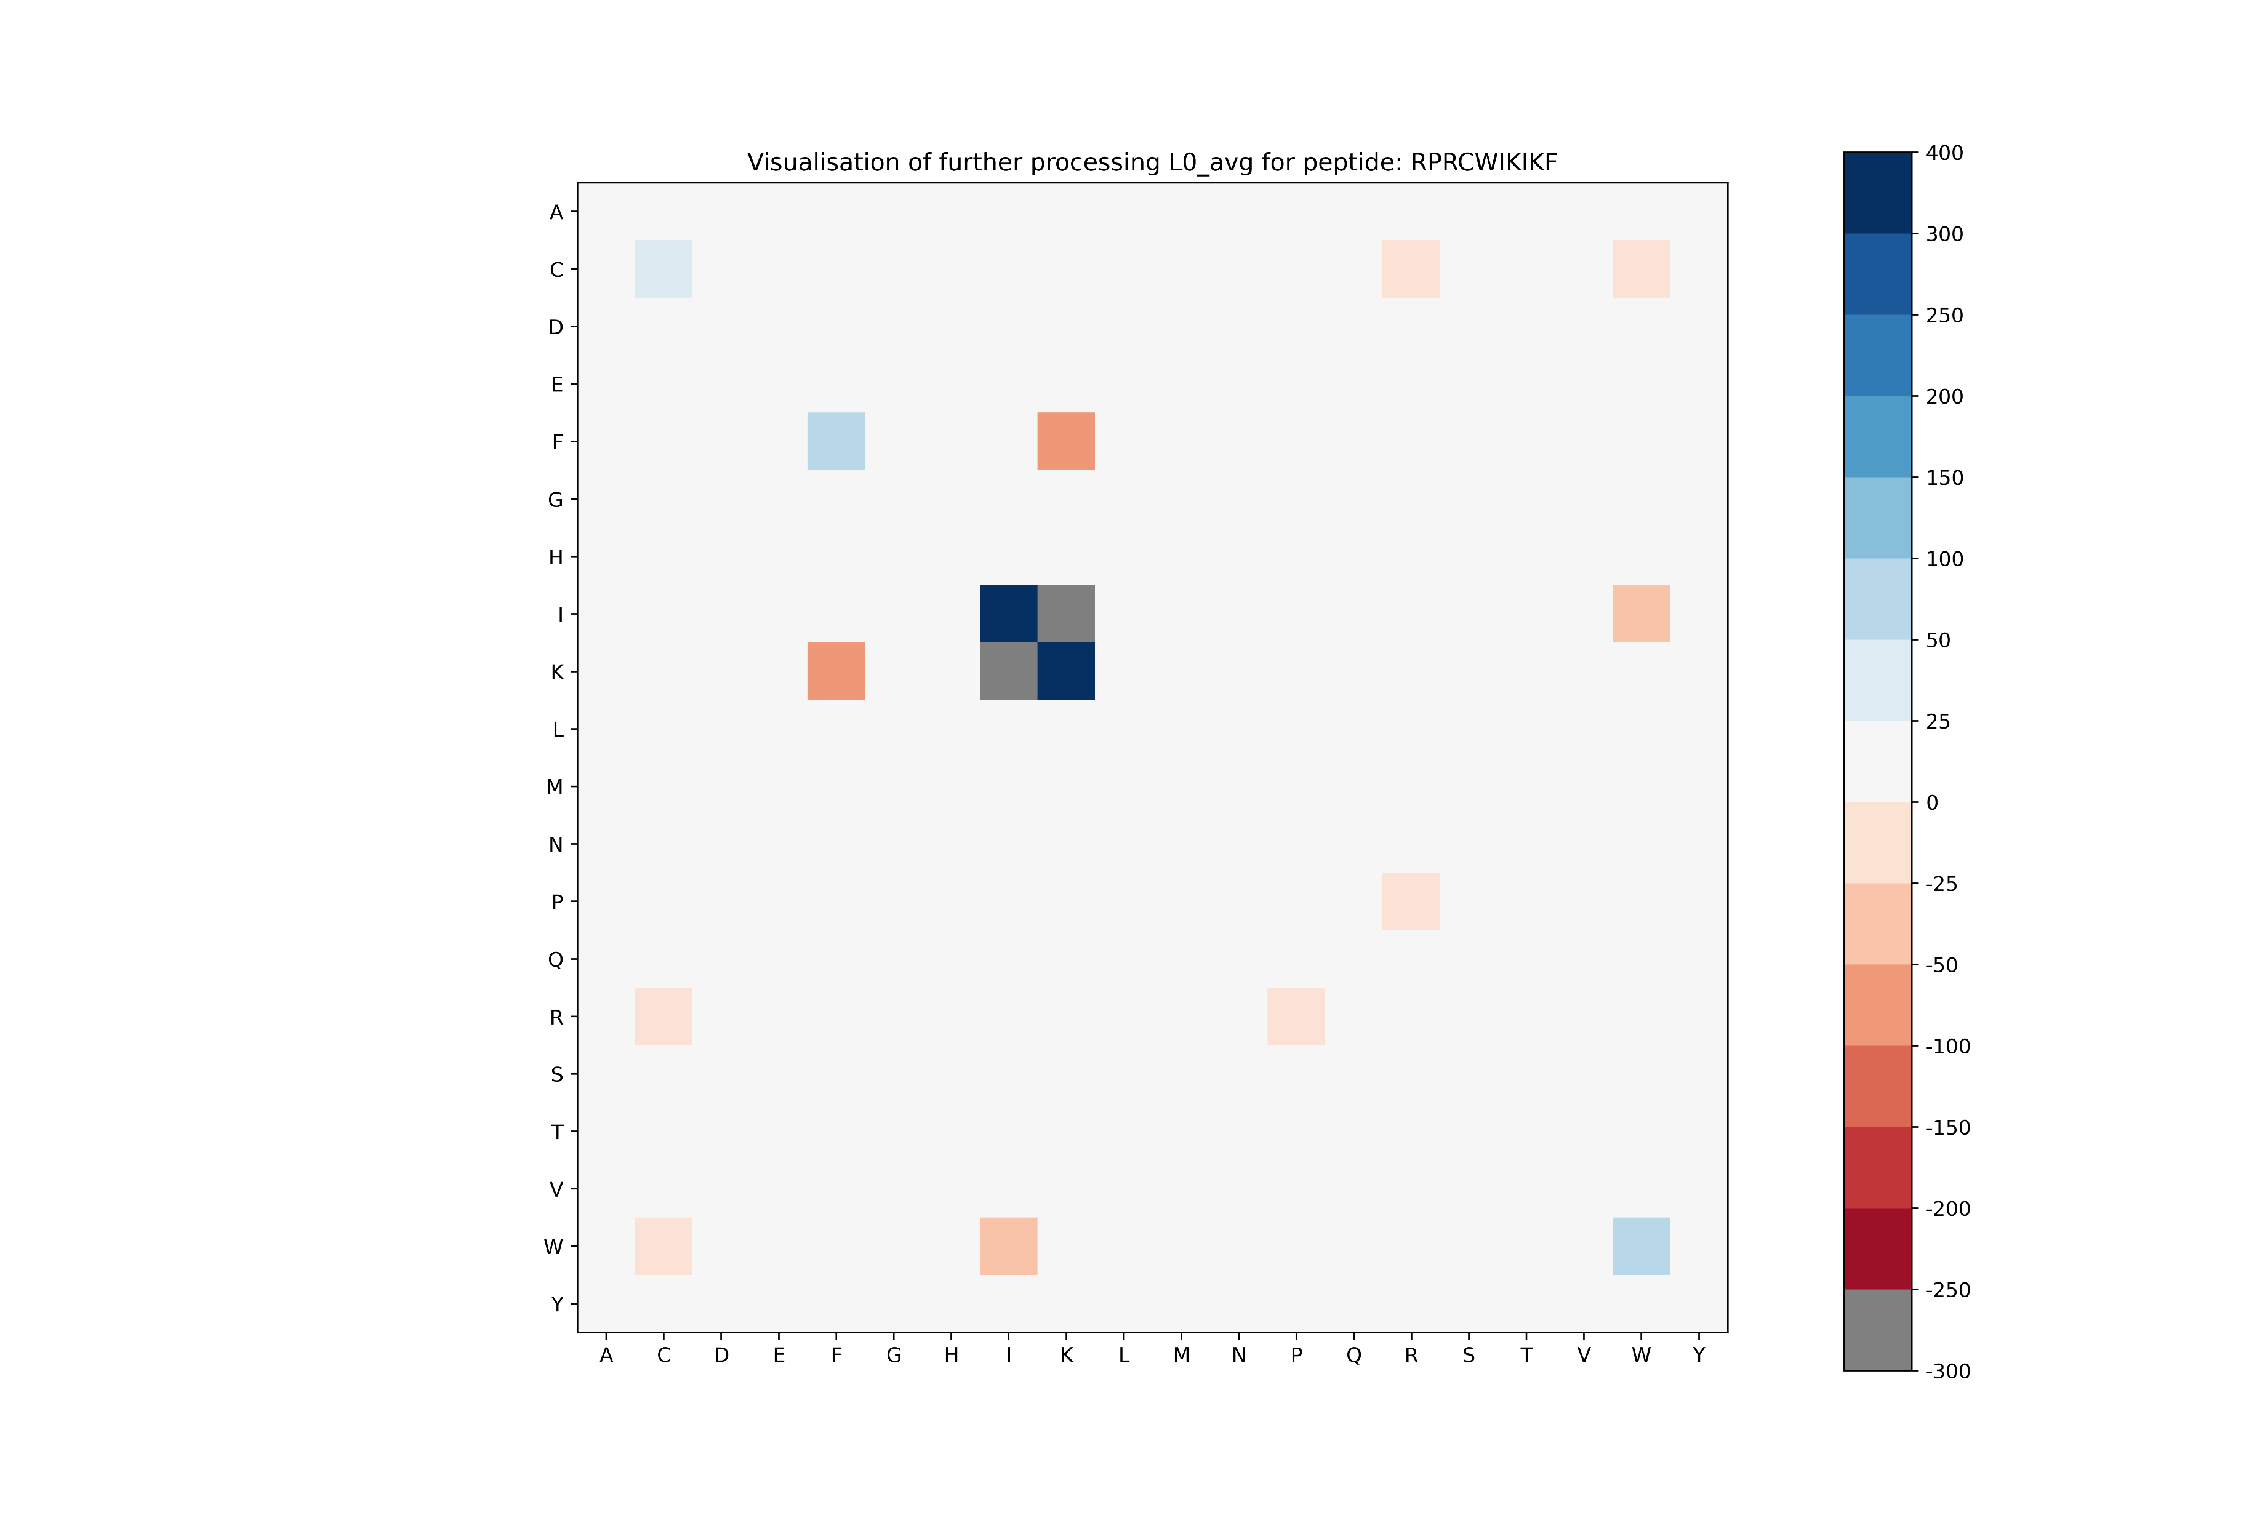
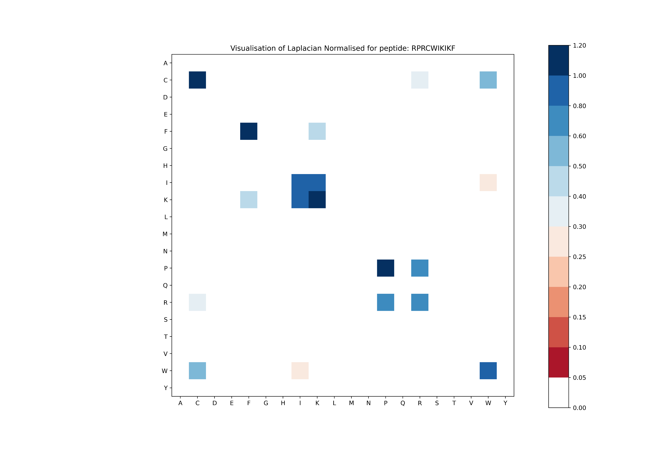
Updated diagrams for RPRCWIKIKFRCKSLKF (L0_avg)
Unormalized
Normalized
test

Slide 2
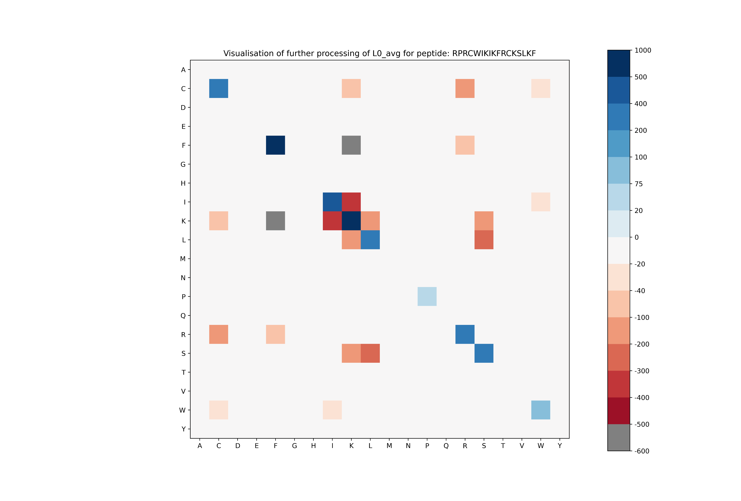
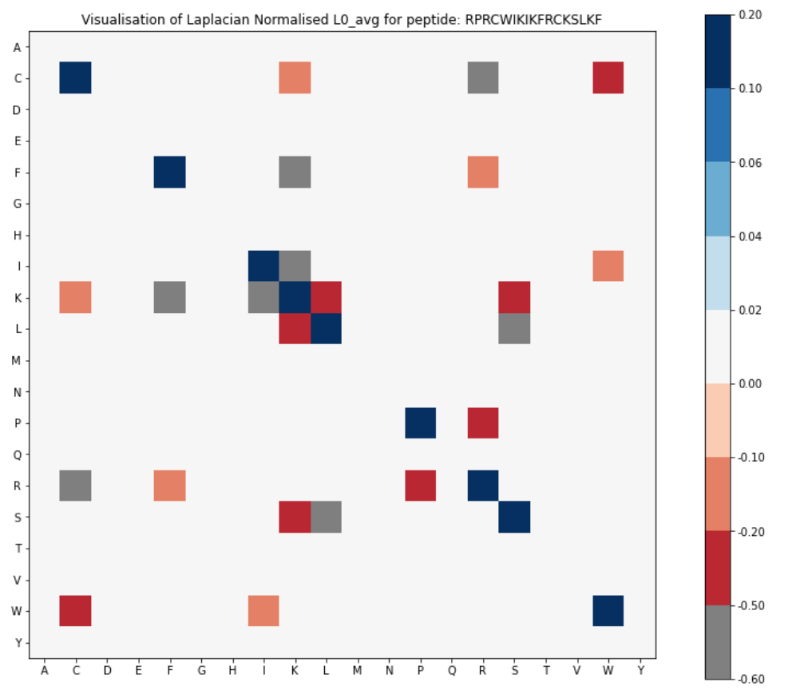
Updated diagrams for RPRCWIKIKFRCKSLKF (L0_avg)
$$L_{0}$$
$${\tilde{L}}_{0}$$
(a)
(b)

Slide 3
Unormalized

Slide 4
Normalized

Slide 5
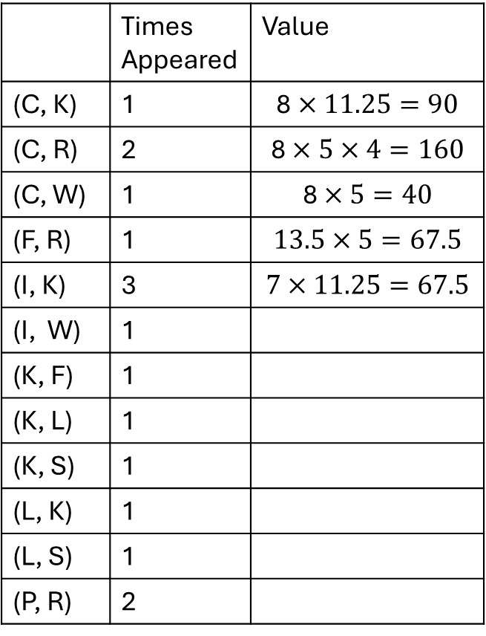
RPRCWIKIKFRCKSLKF
 | Times Appeared | Value
(C, K) | 1 | $$\text{8}×11.25=90$$
(C, R) | 2 | $$\text{8}×5×4=160$$
(C, W) | 1 | $$\text{8}×5=40$$
(F, R) | 1 | $$\text{1}\text{3.5}×5=67.5$$
(I, K) | 3 | $$\text{7}×11.25=67.5$$
(I, W) | 1
(K, F) | 1
(K, L) | 1
(K, S) | 1
(L, K) | 1
(L, S) | 1
(P, R) | 2
C | 8
F | 13.5
I | 7
K | 11.25
L | 15
P | 2
R | 5
S | 14
W | 5

Slide 6
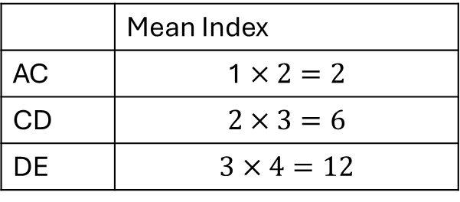
ACD
Unormalized L_0
 | Mean Index | Freq
A | 1 | 1
C | 2 | 1
D | 3 | 1
E | 4 | 1
Mean Indes | A | C | D
A | 2 | -2 | 0
C | -2 | 8 | -6
D | 0 | -6 | 6
Freq | A | C | D
A | 1 | -1 | 0
C | -1 | 1 | -1
D | 0 | -1 | 1
 | Mean Index
AC | $$\text{1}×2=2$$
CD | $$\text{2}×3=6$$
DE | $$\text{3}×4=12$$

Slide 7
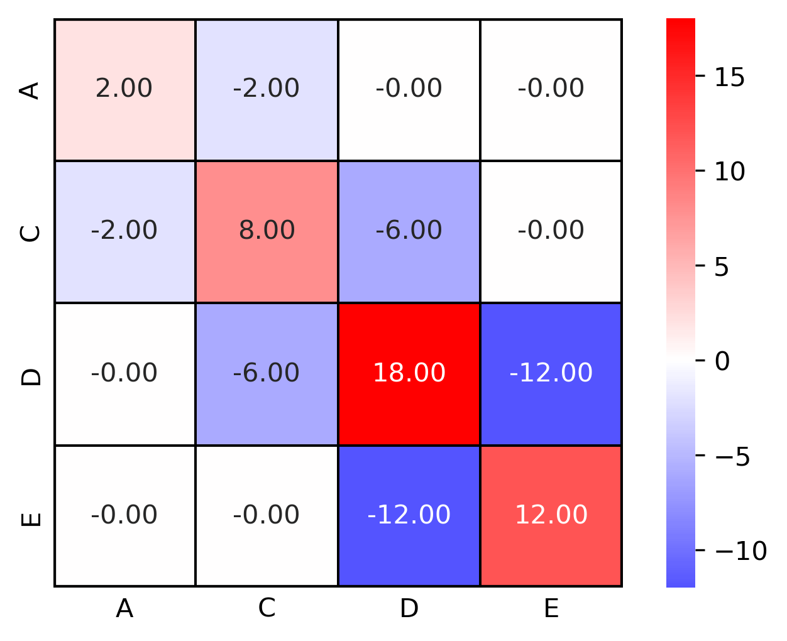
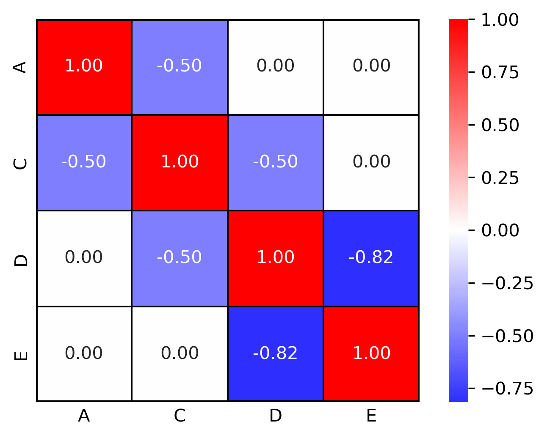
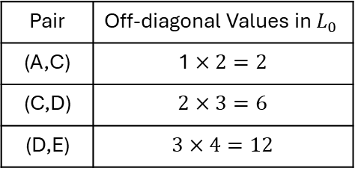
Sequence | A | C | D | E
Mean Index | 1 | 2 | 3 | 4
Pair | Off-diagonal Values in $L_{0}$
(A,C) | $$\text{1}×2=2$$
(C,D) | $$\text{2}×3=6$$
(D,E) | $$\text{3}×4=12$$
(a)
(b)
(c)

Slide 8
Normalized

